Slide 1

Getting started with NodeMCU
Module
Rohit Kumar

Slide 2
Contents
Title | Page
What is NodeMCU
ESP8266 Features
Basic AT Commands
NodeMCU DEVKIT 1.0 Specification
NodeMCU Pinout
How to Setup it
Uploading of sketch
Result

Slide 3
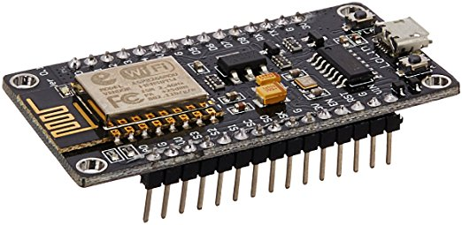
What is NodeMCU
NodeMCU is an open source IoT platform. Which includes firmware which runs on the ESP8266 Wi-Fi Module from Espressif Systems, and hardware which is based on the ESP-12 module. The term “NodeMCU” by default refers to the firmware rather than the dev kits. NodeMCU firmware was developed so that AT commands can be replaced with Lua scripting making the life of developers easier. So it would be redundant to use AT commands again in NodeMCU.
The ESP8266 is a low-cost Wi-Fi chip with full TCP/IP stack and microcontroller capability produced by Shanghai-based Chinese manufacturer, Espressif.

Slide 4
ESP8266 Feature
Open-source
Interactive
Programmable
Low cost
Simple
Smart
WI-FI enabled
USB-TTL included
Plug & Play

Slide 5
NodeMCU DEVKIT 1.0 Specification
Developer : ESP8266 Opensource Community
Type : Single-board microcontroller
Operating system : XTOS
CPU : ESP8266
Memory : 128kBytes
Storage : 4MBytes
Power By : USB
Power Voltage : 3v ,5v(used with 3.3v Regulator which inbuilt on Board using Pin VIN)
Code : Arduino Cpp
IDE Used : Arduino IDE GPIO : 10

Slide 6
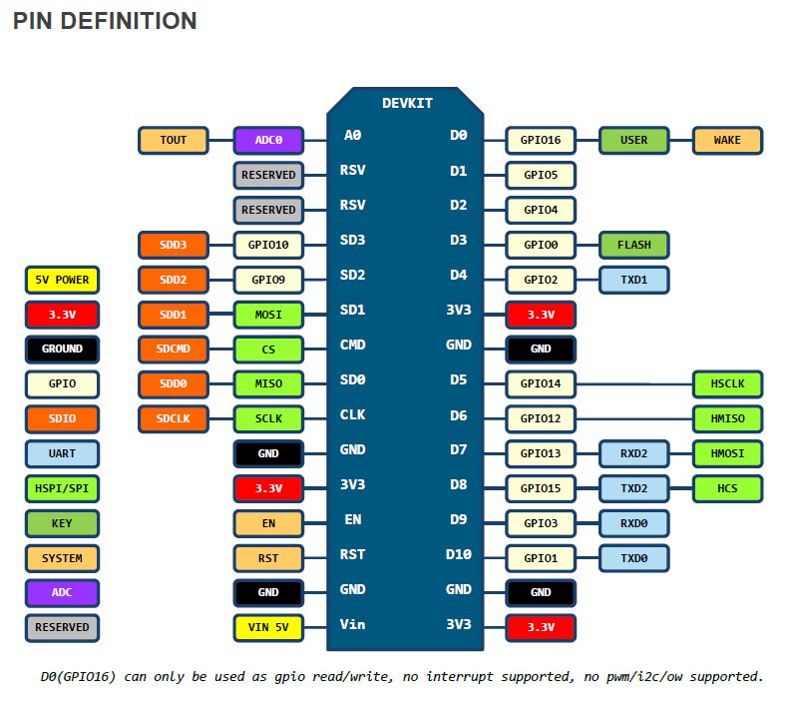
NodeMCU Pinout

Slide 7
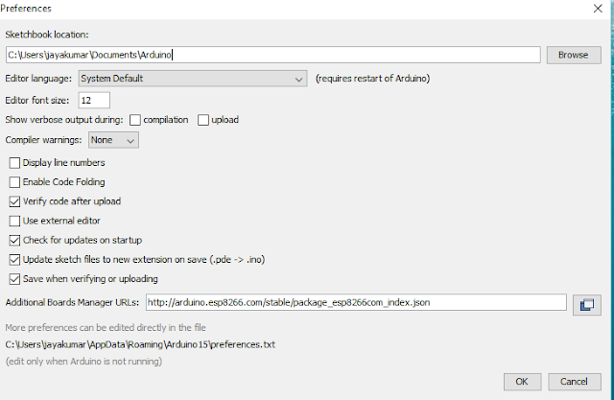
How to Setup it
Install the current upstream Arduino IDE at the 1.8 level or later. The current version is at the Arduino website.
Start Arduino and open Preferences window.
Enter http://arduino.esp8266.com/stable/package_esp8266com_index.json into Additional Board Manager URLs field.
Click OK to close the preference Tab.

Slide 8
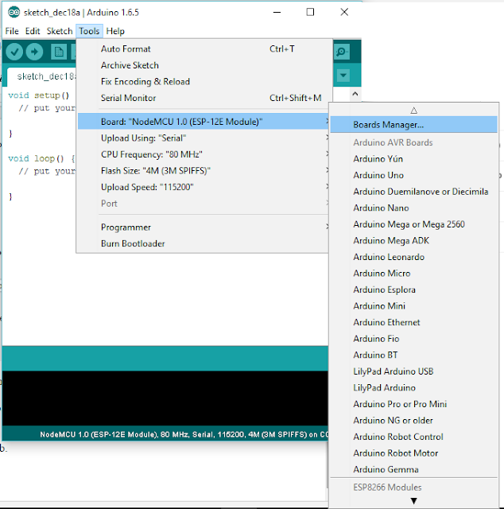

After completing the above steps , go to Tools and board, and then select board Manager

Slide 9
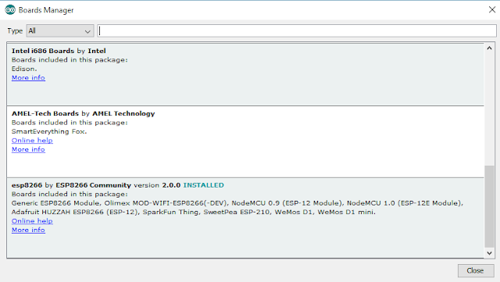
Navigate to esp8266 by esp8266 community and install the software for Arduino.
Once all the above process been completed we are read to program our esp8266 with Arduino IDE

Slide 10
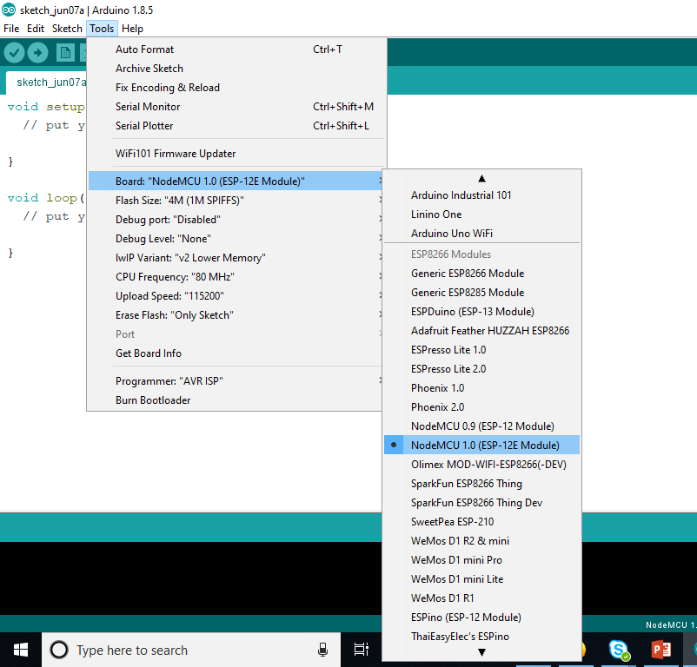
Open Boards Manager from Tools > esp8266 Modues platform And Select NodeMCU 1.0(ESP-12E Module) board from Tools .
Upload Using : Serial
CPU Frequency : 80Mhz
Flash Size: 4M
Upload Speed: 115200
PORT : Select Assign Port Only.

Slide 11
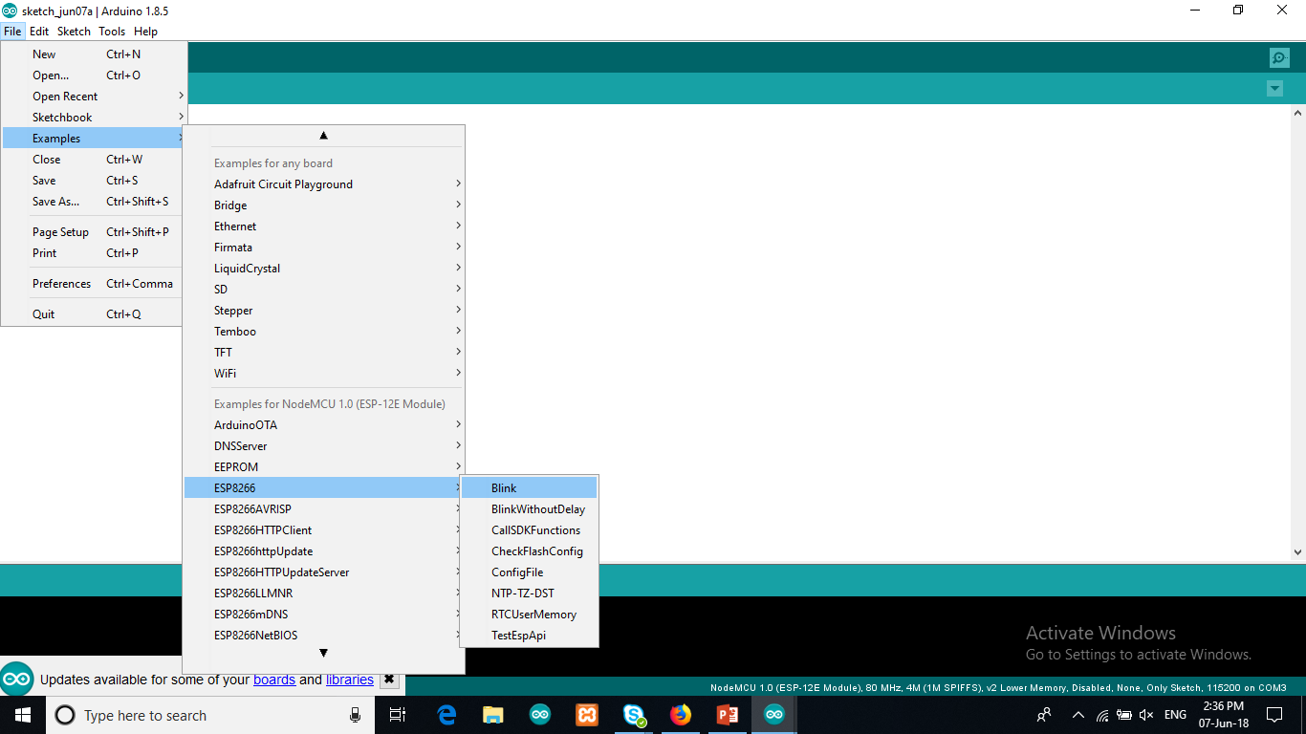
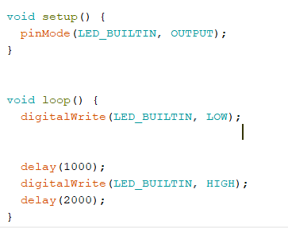
Uploading sketch
Go to file tab -> Examples -> ESP8266-> Blink.
Upload the program in NodeMCU by selecting the correct port.

Slide 12
Result
After uploading the program you will find that the built-in led of NodeMCU start blinking.
Now , we are done with the setup.

Slide 13
Thank You !
Contact US
Nitin Sinha
nitin.sinha@goSigmaWay.com
+1 727-394-4375
+91 7838188809
Debjani Mitra
debjani.mitra@goSigmaWay.com
+1 952-583-3449
+91 9339555636
Rohit Kumar
rohit.kumar@sigmaway.us
+91 7982577830
+91 7838021754

